Slide 1
Optimizing CNN Model Inference on CPUs Yizhi Liu, Yao Wang, Ruofei Yu, Mu Li, Vin Sharma, and Yida Wang, Amazon
王彦均

Slide 2
Content
Introduction & Background
Optimizations
Evaluation
Conclusion

Slide 3
Contributions
Provides an operation- and graph-level joint optimization scheme to obtain high CNN model inference performance on different popular CPUs including Intel, AMD andARM,whichoutperformsthecurrentstate-of-the-art implementations
Constructs a template to achieve good performance of convolutions, which is ﬂexible to apply to various convolution workloads on multiple CPU architectures (x86 and ARM) without relying on high-performance kernel libraries
Designs a global scheme to look for the best layout combination in different operations of a CNN model, which minimizes the data layout transformation overhead between operations while maintaining the high performance of individual operations

Slide 4
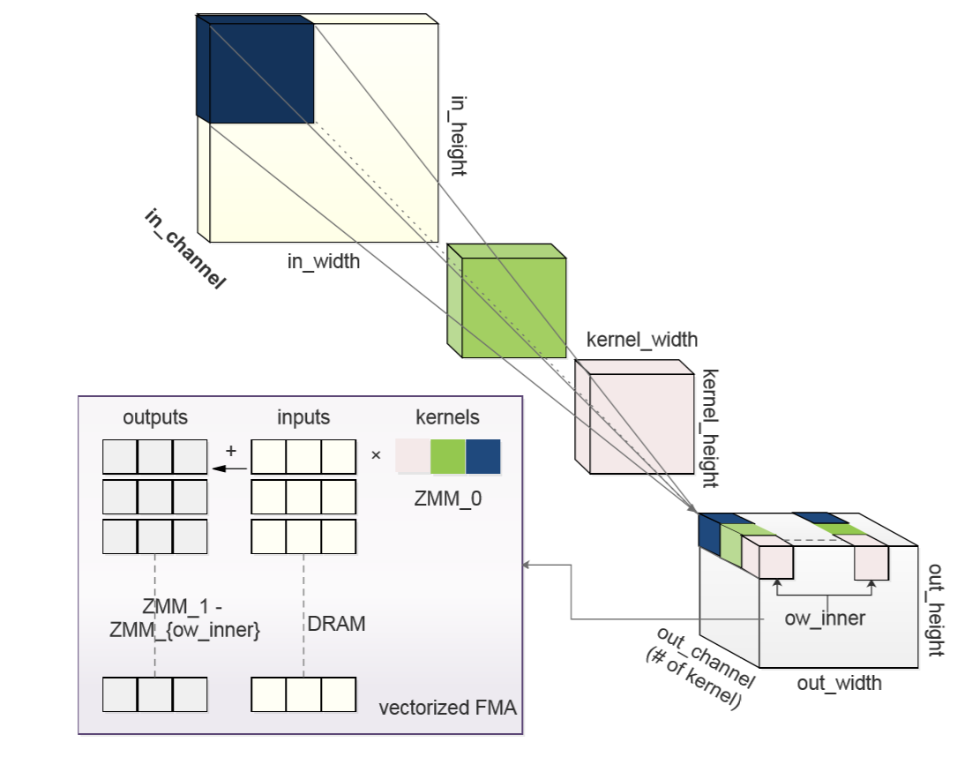
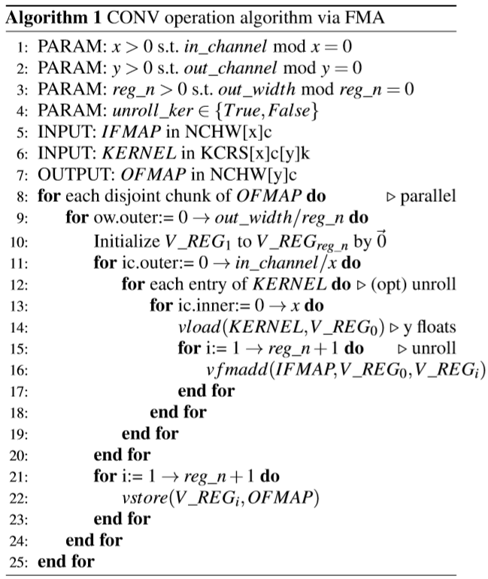
Optimizations——Operation optimization

Slide 5
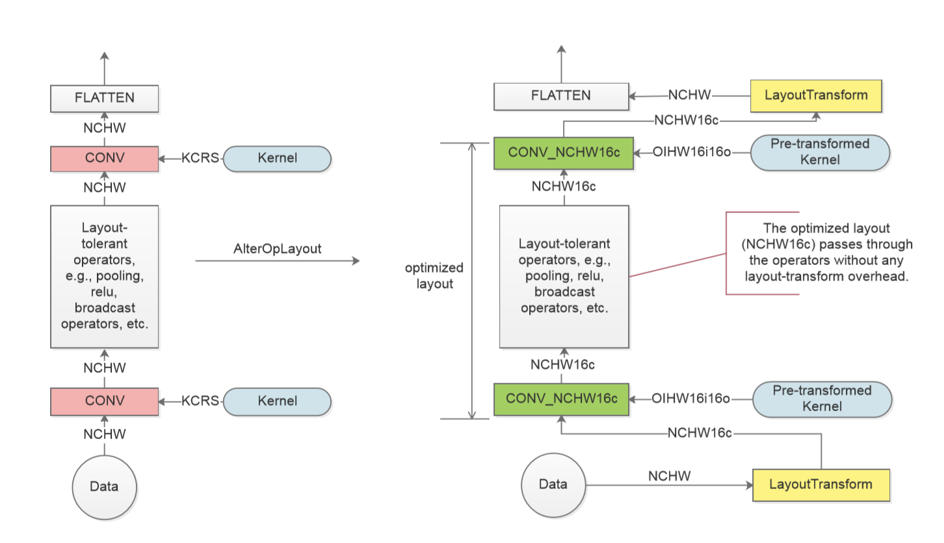
Optimizations——Layout transformation elimination

Slide 6
Optimizations——Optimization scheme search
tuple (ic_bn, oc_bn, reg_n, unroll_ker)
the local search works as follows
Deﬁne the candidate lists of ic_bn and oc_bn
Deﬁne the candidate list of reg_n.
Deﬁne the candidate list of unroll_ker to be [True,False]
Walk through the deﬁned space ，This eventually generates a list of combinations ascendingly ordered by their execution time.

Slide 7
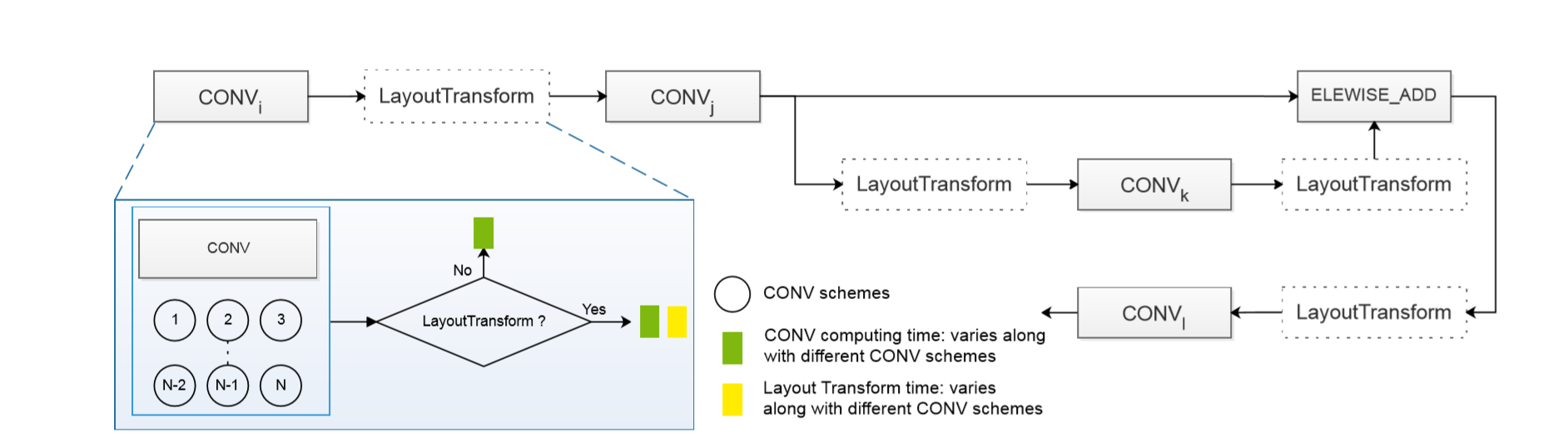
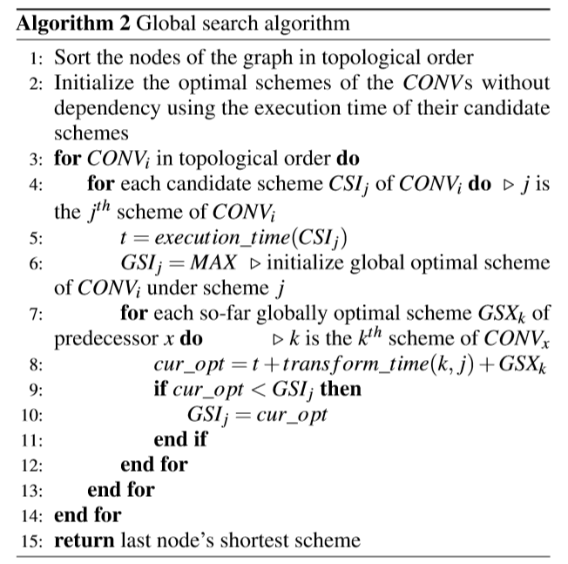
Optimizations——Optimization scheme search

Slide 8
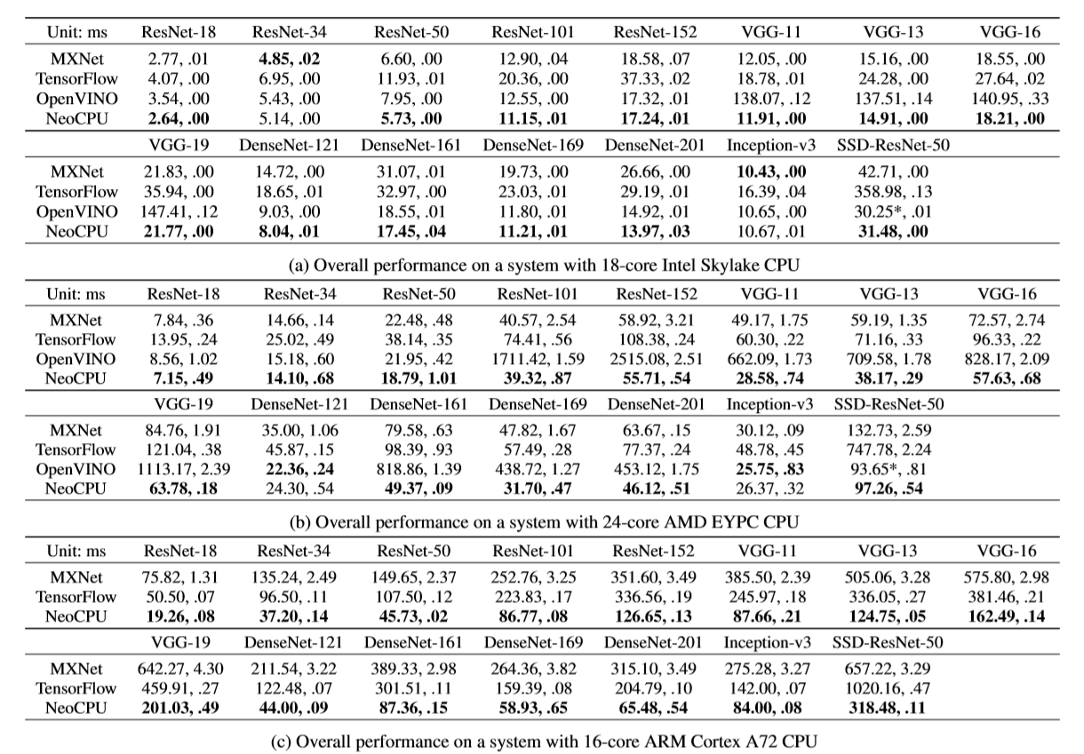
Evaluation

Slide 9
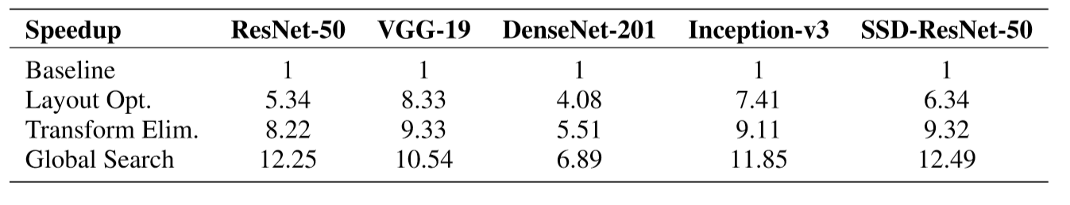
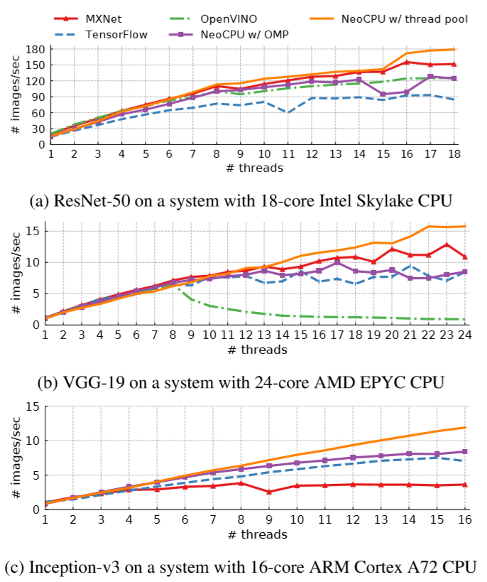
Evaluation

Slide 10
Conclusion
In this paper, we proposed an end-to-end solution to compile and optimize convolutional neural networks for efﬁcient model inference on modern CPUs.
The experiments show that we are able to achieve up to 3.45× speedup on 15 popular CNN models on the various kinds of CPUs compared to the performance of the state-of-the-art solutions.

Slide 11
thanks

